Slide 1
Field Data Collection Basics
OCE2901 – Surf Engineering Analysis

Slide 2


Introduction: How much time do you have remaining?
8 Days – Field Experiment Dry Run (02/03)
15 Days – G1 Field Experiment Wet Run (02/10)
22 Days – G2 Field Experiment Wet Run (02/17)
29 Days – G1 First field deployment (~02/24)
36 Days – G2 First field deployment (~03/03)
This Photo by Unknown Author is licensed under CC BY-NC-ND

Slide 3
Planning
Part One

Slide 4
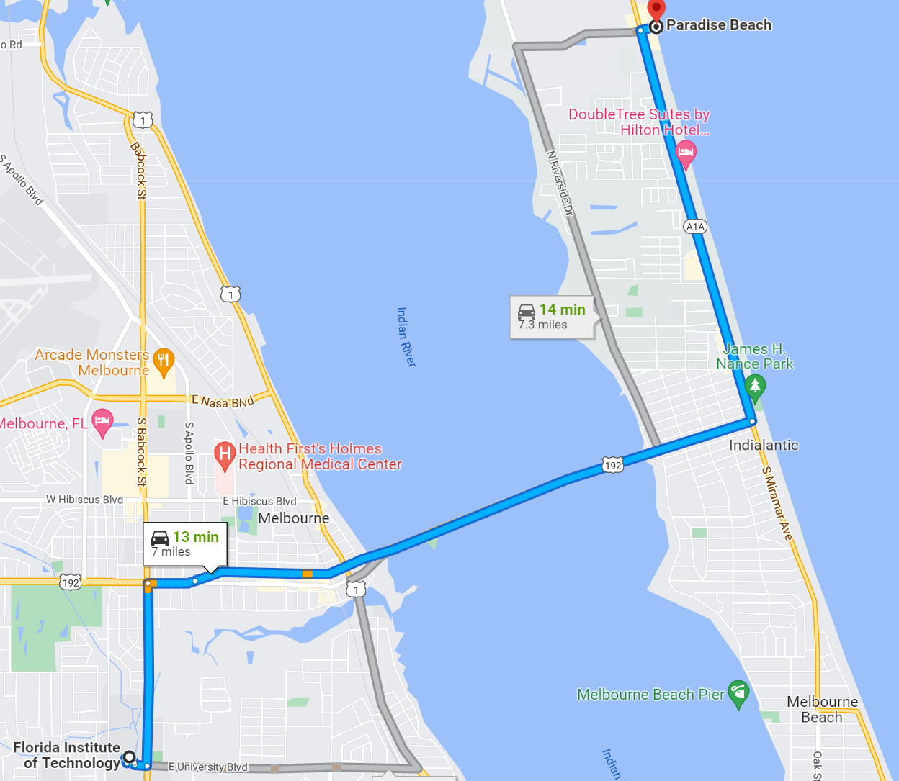
Location, Location, Location
Field Deployments will occur at Paradise Beach
Time and specific dates to be determined shortly
Think about how you will get yourselves and your gear to the beach.
Are you carpooling? Who has the space for the surfboards? What if someone gets into a car accident?

Slide 5
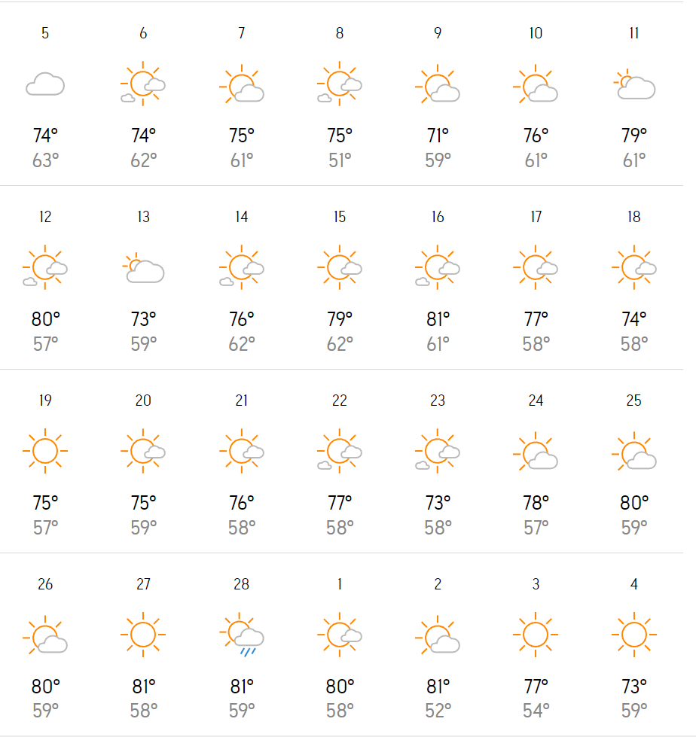
Weather
UV Indexes will typically be MEDIUM to HIGH
Strongly recommend sunblock!
Water won’t be frigid, but you may need a wetsuit early on
Air temperature will be cool
Especially for the early deployments and especially if it is windy
No hurricanes (hopefully), but sudden storms may be possible
Always consult the weather forecast at least 48 hours up to a deployment and within 12 hours!
Safety Coordinators – monitoring the weather will be part of your job. If you don’t like it, you don’t have to go out in it!

Slide 6
Mobilization
Who has what assets where and when do they need to be at a place by?
We will have two teams operating mostly independently, gear will be stowed in different places at different times.
Getting ready early and having a well-thought-out plan for who is taking what will save you some headache!
Make sure that people who are handling gear show up on time and are reliable!
Technicians – it is part of your job to handle the mobilization of the gear your team needs for deployment. You must be able to track your group’s assets and make sure the tools are available for you to use.
Principal Investigators – It is also part of your job to ensure that the gear you need is available; if you can’t find or need something, inform the other PI and the instructor(s) ASAP so we can help.

Slide 7
Each member should have a specific task to do during the data collection process
If there is nothing to specifically do, making detailed observations and records is always an option!
Outline each person’s roles and responsibilities thoroughly and document in your procedure
Address any misconceptions, questions, or misgivings well before going into the field
Roles and Responsibilities
Principal Investigators – Your job is to make sure everyone has appropriate tasks that they can achieve. You should also be overseeing the operation. However, your team members should not normally be relying on you or your supervision. Trust them to do the jobs they’ve been assigned and only intervene/take over when needed.

Slide 8
No plan survives first contact with the enemy.
What does this mean for you all?
Helmuth von Moltke the Elder, 1871
Schedule
Principal Investigators – Part of your job is managing the timeline while in the field. Make sure your team’s time is spent wisely and efficiently!
Notes:
No matter what schedule you produce, it will mean nothing when you get to the field. Just try to be flexible and efficient with your tasks and reduce downtime where possible.

Slide 9
Safety
Part Two

Slide 10
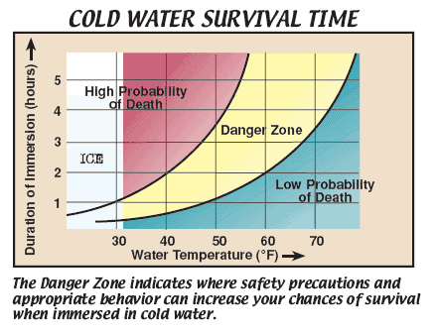
Exposure
Safety Coordinators –establishing and maintaining adequate shelter will be part of your job in the field. Make sure there is shade and water and sunblock for everyone!
Exposure: the condition of being subjected to something, as to infectious agents or extremes of weather or radiation, which may have a harmful effect.
What are some other potential exposure risks?
Notes:
Sun burns, hypothermia, hyperthermia, dehydration, heat stroke

Slide 11

Operational Risk Management
Identify Hazards
Step 1. Identify hazards - A hazard is any condition with the potential to negatively impact mission accomplishment or cause injury, death, or property damage. Hazard identification is the foundation of the entire RM process. If a hazard is not identified, it cannot be controlled.
Assess the Hazards
Step 2. Assess the hazards - For each hazard identified, determine the associated degree of risk in terms of probability and severity. Assign it a Risk Assessment Code in accordance with the matrix coming up.
Make Risk Decisions
Step 3. Make risk decisions - A key element of the risk decision is determining if the risk is acceptable. This decision must be made at the right level by the individual who can balance the risk against the mission or task potential benefit and value.
Implement Controls
Step 4. Implement controls - Once the risk control decisions are made, the next step is implementation. This requires that the plan is clearly communicated to all the involved personnel, accountability is established, and necessary support is provided.
Supervise
Step 5. Supervise - Supervise and review involves determining the effectiveness of risk controls throughout the mission or task. This involves three actions: monitoring the effectiveness of risk controls; determining the need for further assessment of all or a portion of the mission or task due to an unanticipated change; and capturing lessons learned, both positive and negative.

Slide 12
Accept risks only when benefits outweigh costs
Never accept unnecessary risk
Anticipate and manage risk by planning
Make decisions at the right level with the right people

Slide 13
Risk Assessment Codes - Severity
I. CATASTROPHIC
Loss of the ability to accomplish the mission. Death or permanent total disability. Loss of a mission-critical system or equipment. Major facility damage. Severe environmental damage. Mission-critical security failure. Unacceptable collateral damage.
II. CRITICAL
Significantly degraded mission capability or unit readiness. Permanent partial disability or severe injury or illness. Extensive damage to equipment or systems. Significant damage to property or the environment. Security failure. Significant collateral damage.
III. MODERATE
Degraded mission capability or unit readiness. Minor damage to equipment, systems, property, or the environment. Minor injury or illness.
IV. NEGLIGIBLE
Little or no adverse impact on mission capability or unit readiness. Minimal threat to personnel, safety, or health. Slight equipment or systems damage, but fully functional and serviceable. Little or no property or environmental damage.

Slide 14
Risk Assessment Codes - Probability
A. Frequent
Frequent to occur. Continuously experienced to an individual item or person; or continuously over a service life for an inventory of items or group.
B. Likely
Likely to occur, immediately or within a short period of time. Expected to occur frequently to an individual item or person; or continuously over a service life for an inventory of items or group.
C. Occasional
Occasionally will occur in time. Expected to occur several times to an individual item or person; or frequently over a service life for an inventory of items or group
D. Seldom
Seldom may occur in time. Can reasonably be expected to occur sometime to an individual item or person; or several times over a service life for an inventory of items, or group.
E. Unlikely
Unlikely it will occur in time. Unlikely to occur, but possible in the service life for an inventory of items, or group.

Slide 15
Risk Assessment Codes - Matrix
Risk Assessment Matrix |  |  | PROBABILITY
 |  |  | Frequency of Occurrence over Time
 |  |  | A | B | C | D | E
SEVERITY | Effect of Hazard | I | 4 | 4 | 3 | 3 | 2
 |  | II | 4 | 3 | 3 | 2 | 1
 |  | III | 3 | 2 | 2 | 1 | 1
 |  | IV | 2 | 1 | 1 | 1 | 1
 |  |  | Risk Assessment Levels
 |  |  | 4 = Extremely High, 3= High, 2 = Medium, 1 = Low

Slide 16
ORM Assessment
Risk | Definition | Severity | Probability | RAC
Drowning | Loss of consciousness or death due to extended submersion | I | E | 2
What are some other potential risks? How would you define and rate them?

Slide 17
Risk Management Assessment
These are performed at the start of the data collection to perform “Time Critical Risk Management”
Assess
Assess your environment, identify risks
Balance resources
Shift resources and personnel to mitigate risks
Communicate to others
Inform team members about potential risks and concerns
Do and Debrief
Act and monitor results for future change
Safety Coordinators – it is your job to lead the RMA at the start of every field deployment.
Principal Investigators – Its part of your job to ensure the RMA is followed properly

Slide 18
Risk Management Assessment
As a group vote on the severity rating for a given risk based on the observed value and your acceptable and maximal limits
The rating applied to each risk is the highest provided by any individual
There is absolutely no pressuring to change values
Risks are rated on a scale of 1-5
1: Negligible
2: Some
3: Considerable
4: Consequential
5: Unacceptable
- Discuss mitigations and safety procedures
- Enact stricter safety protocols, wait for conditions to change favorably
- Stop test and recycle for next attempt

Slide 19
Risk Management Assessment
Risk | Definition | Acceptable Range | Maximum Range | Rating (1-5)
Waves | Drowning or personal injury; damage to equipment due to excessive wave height | 1-3 feet | 4 feet | 1
Exposure (Sun) | Heat stroke, sunburns, exhaustion, dehydration due to excessive time in the sun/heat | 1 hour continuous @ 80 deg F | 3 hours continuous @ 80 deg F | 2
Exposure (Water) | Hypothermia, drowning or personal injury due to excessive time in the water | 1 hour continuous @ 71 deg F | 4 hours continuous @ 71 deg F | 1
Basically, these are slimmed down, quick versions of the ORM Assessments

Slide 20
In preparing for battle I have always found that plans are useless, but planning is indispensable.
Dwight D. Eisenhower
Notes:
No matter what schedule you produce, it will mean nothing when you get to the field. Just try to be flexible and efficient with your tasks and reduce downtime where possible.

Slide 21
In The Field
Part Three

Slide 22

Arriving at the Test Site
Surfers – it is recommended that you arrive a bit earlier to identify good surf zones.
Be sure to arrive on-time and at the right location
Take the time to locate and establish a base of operations
Should include:
Table
Tent
Technician’s laptop
Etc.
What else could go in your basecamp?

Slide 23
Pre-Deployment Briefing
Principal Investigator leads the briefing highlighting:
Team member roles and responsibilities
Test objectives
Etc.
Safety Coordinator leads a safety briefing (RMA)
Identify potential risk categories
Rate each one on a severity from 1-5
Conduct as soon as all team members are present

Slide 24
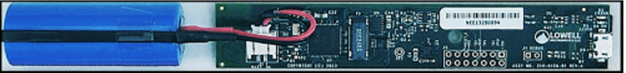
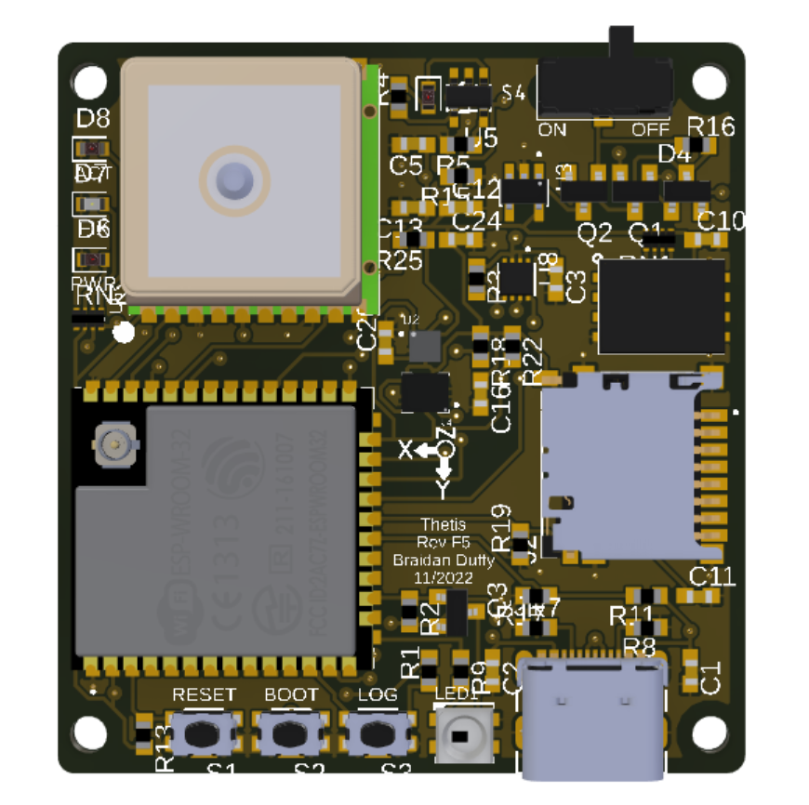
Checking the Equipment
Ensure that you have all the equipment you need
It would be prudent to test that the equipment is working before deploying
The Lowell Instruments have an LED that you can set to blink every second
Thetis has an LED that visualizes the current status
Pulsing blue: Standby, No GPS
Solid blue: Logging, No GPS
Pulsing green: Standby, GPS
Solid green: Logging, GPS
Flashing red: Error
The HOBOs do not have any indicator

Slide 25
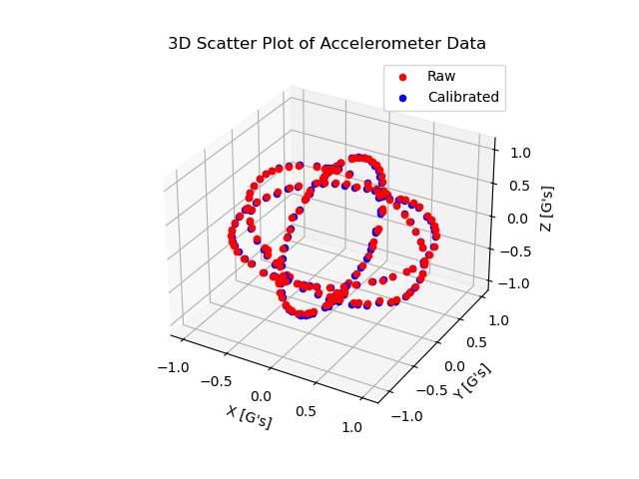
Calibration
Can you trust your equipment? Why or why not?
These sensors have biases and scale factors that account for the sensitivity, misalignment, drift, and error in the measurements
Calibration is the process of calculating these values to improve the accuracy of the sensor
Regular calibration ensures that your data is accurate and the IMU is functioning properly

Slide 26
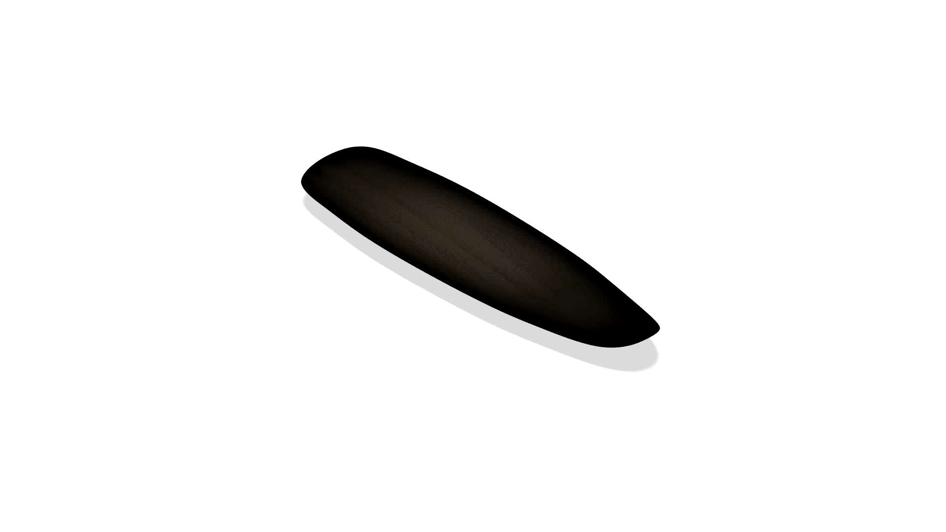
Pitch Calibration

Slide 27

Roll Calibration

Slide 28
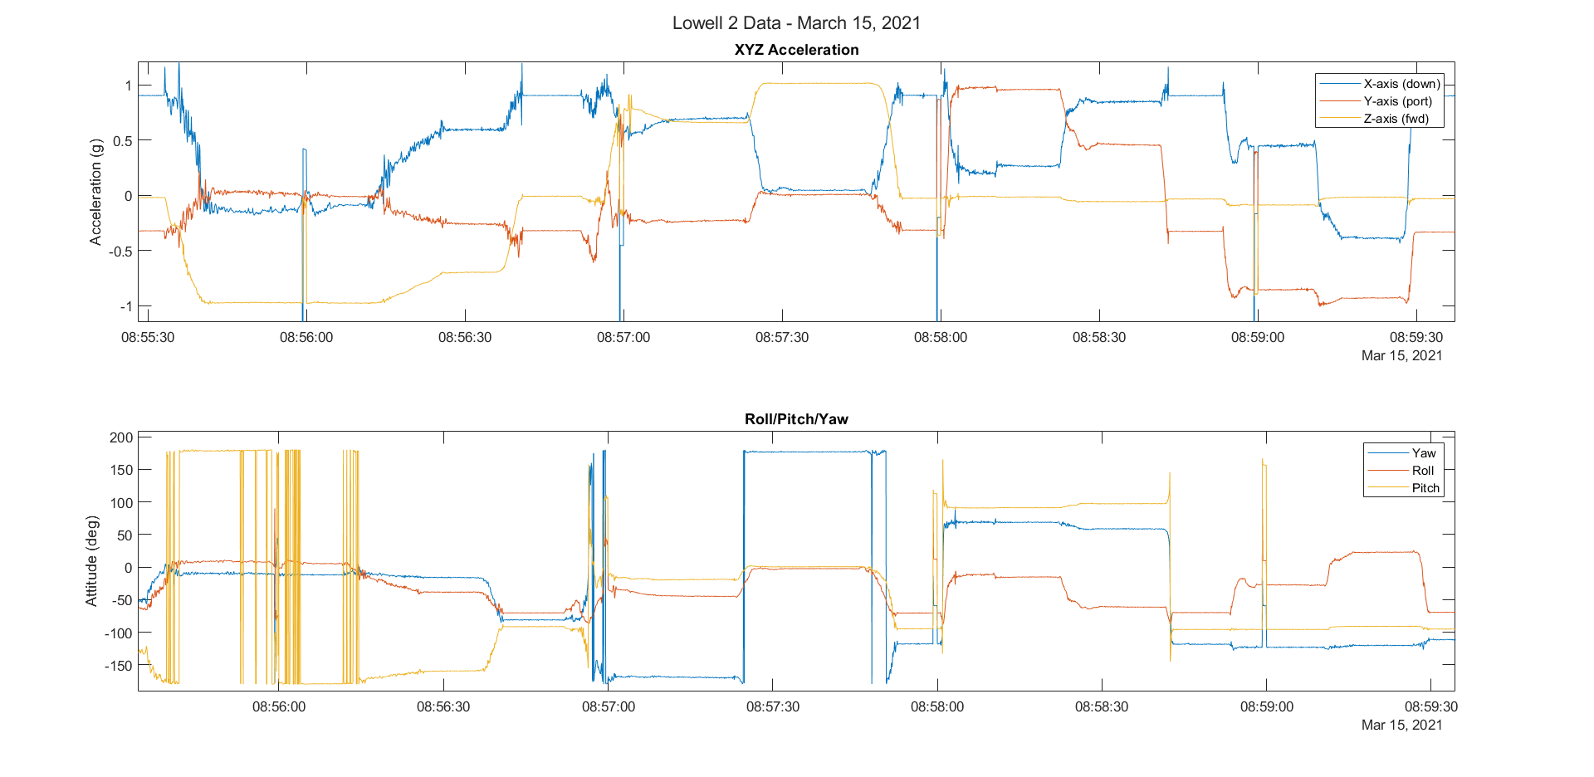
Stationary, lying flat
Stationary, lying flat
Stationary, lying flat
On Nose
Port
Flat
Flat
On Tail
Starboard
Pitch Calibration
Roll Calibration

Slide 29
Why is yaw 180 degrees while pitch is 0 degrees when on its nose?
Why is 180 degrees when it is on its tail?
Why is this not 0 degrees while flat?
What is your conclusion?
Extra Credit: Write me a 500-word maximum, one-page (excluding images) explanation on why this occurs. Use figures to illustrate your explanation.
Notes:
Conclusion, the Lowell attitude measurements are not accurate and cannot be used.

Slide 30


Slide 31

Deployment
Safety, Safety, safety
Make sure you carefully note observations
You might want to create a table where you can quickly jot time, surfer, and what they did
Pictures and videos will be crucial for post-analysis
Technicians – make sure to synchronize the time stamps on all your equipment! Any difference in timing between instruments will ruin your analysis!
How can you use photos and videos in your analysis?

Slide 32
Post Deployment Debrief
Meet with your group and discuss the deployment
What went well
Were the test objectives achieved
What needs to improve
Were there any issues
Does anyone need to be commended?
These notes should be included in your field deployment report!
Principal Investigators – I want a summary checklist at the end of the deployment that notes attendance, which meetings were held, and which test objectives were explored and achieved during the test.

Slide 33
Data Analysis
Part Four

Slide 34
Data Processing
Your team will need to work out how they will analyze the data
Will you be using Python or MATLAB scripts
Who will write what portions of the analysis?
How are you offloading the data?
Who will be analyzing the wave data versus the surf data?
What will the conclusion be?

Slide 35
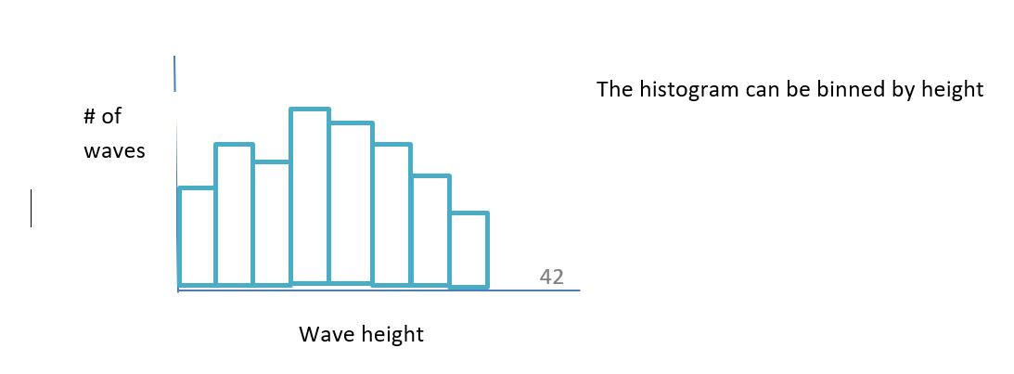
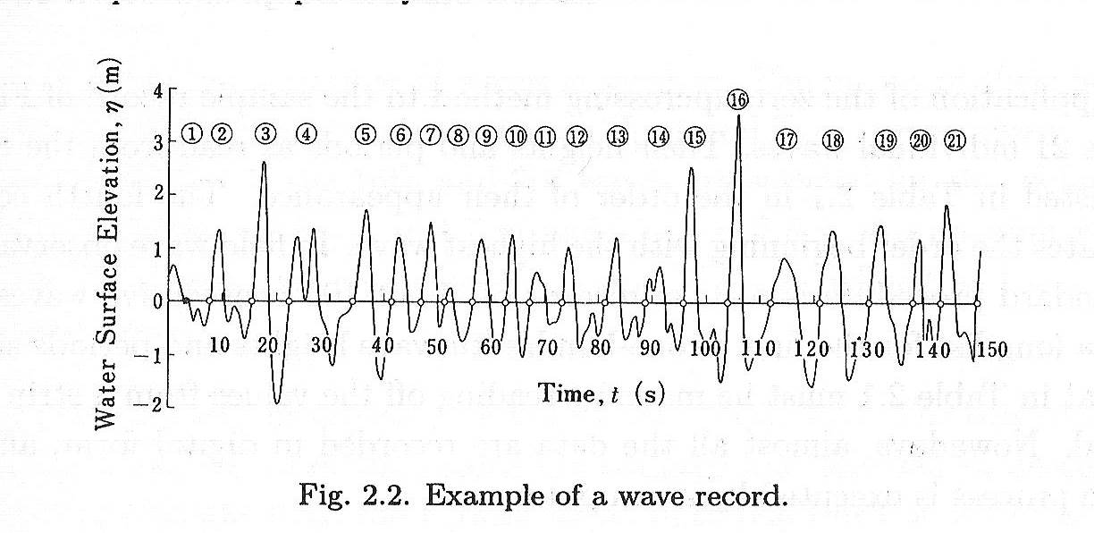
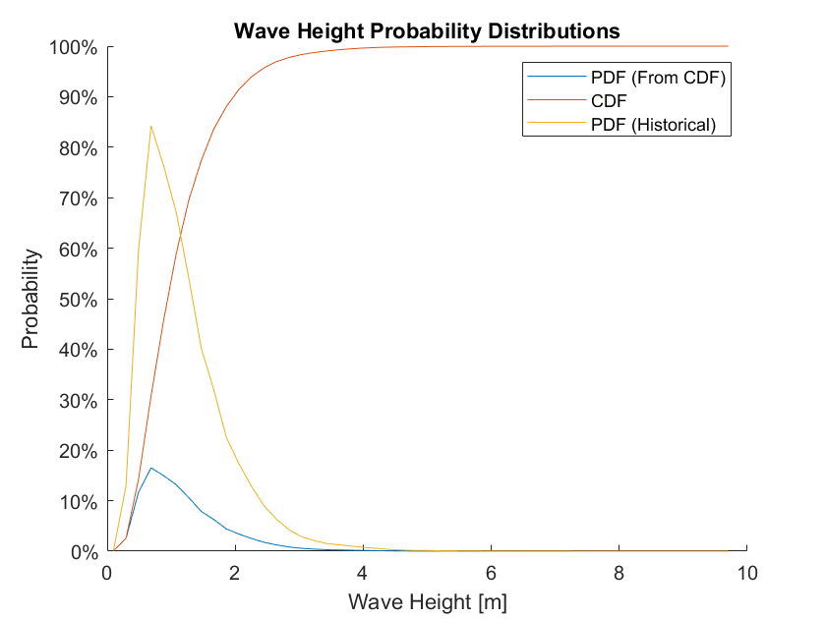


Wave Analysis
Mean $\overline{H}=\frac{1}{n}\sum_{i}{H_{i}}$ (average height)
$$Rms≡H_{rms}=\sqrt{\frac{1}{n}\sum_{i}{H_{i}^{2}}}$$
$$P\left(H>\hat{H}\right)=\frac{n_{H>\hat{H }}}{N}$$

Slide 36
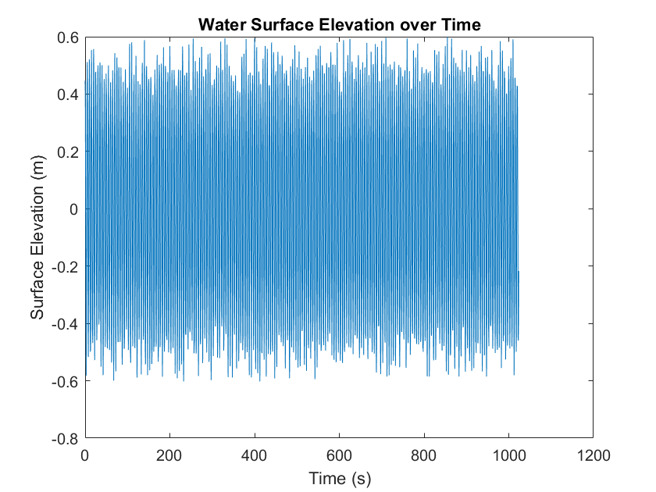
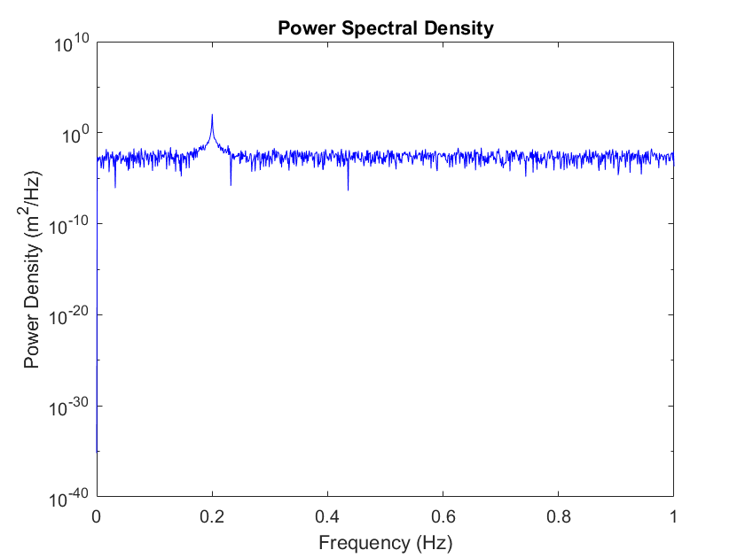
Fourier Wave Analysis

Slide 37
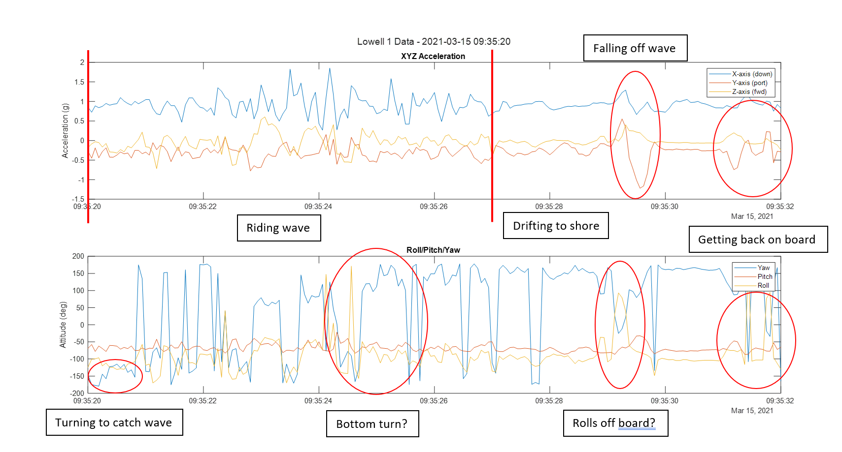

Slide 38
Reports
Reports should be thorough with pictures, graphs, and explanations as appropriate
Think standard lab reports, with some additional information
Title page
Roles and responsibilities
Team member contributions to report
Executive summary
Safety information (RMA)
Test briefing checklist
Detailed analysis
Conclusion
Changes for the future
Principal Investigators – For each test, I want the experimental procedure document (before the test begins), your team’s RMA table, a test checklist, and your team’s deployment report.

Slide 39

Literature Review Quad Chart
Graduate students only!
Friday, January 27

Slide 40

Field Experiment Procedure
First Draft
February 3, 2023

Slide 41

Questions?

